Slide 1
Lab 4
Signal Sampling and Reconstruction

Slide 2
1. Sampling of Continuous Signals
>>sampling(signal_f, over_f,under_f)
The parameter:
signal_f： the frequency of the analog signal;
over_f ： the oversampling frequency
under_f： the undersampling frequency

Slide 3
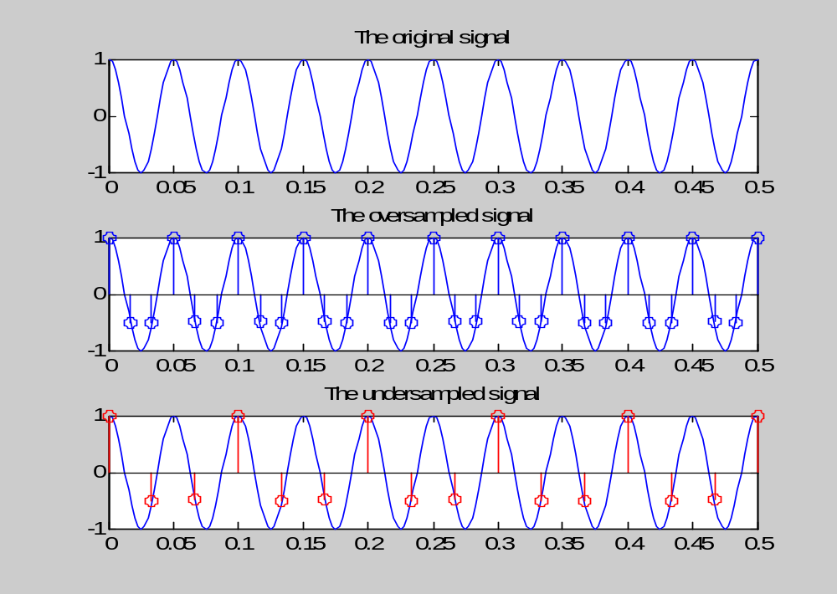
>> sampling(20,60,30);

Slide 4
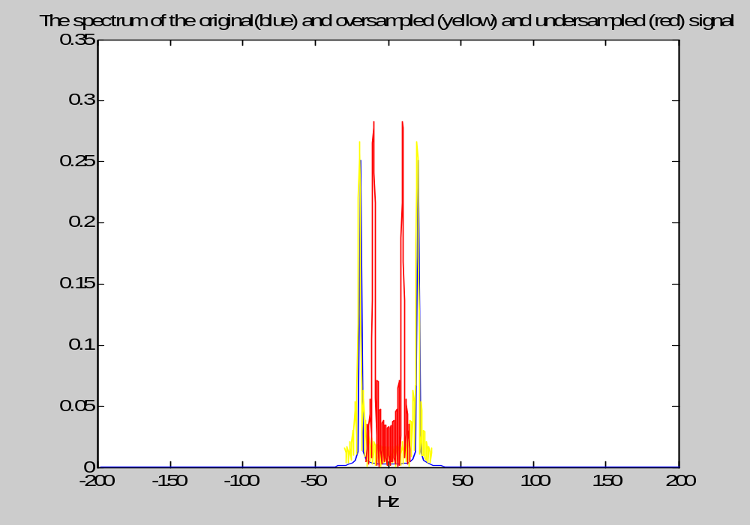

Slide 5
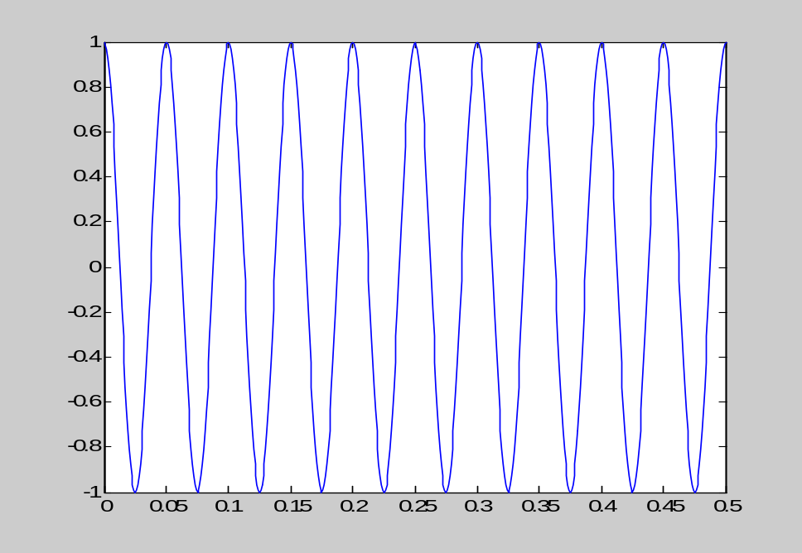
1.1 Plot the sampled signal
signal_f=20
t=0:1/(50*signal_f):0.5;
x=cos(2*pi*signal_f*t);
plot(t,x); % Plot a continuous-time signal

Slide 6
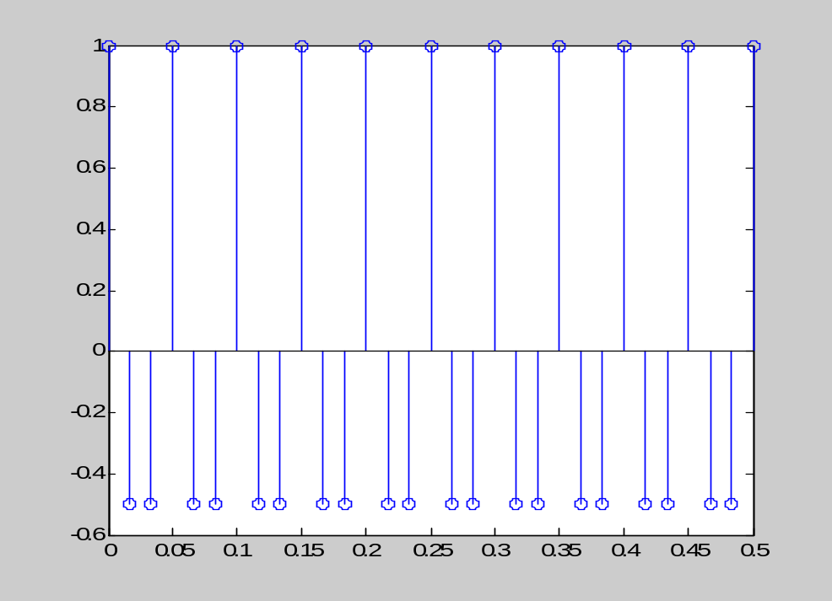
Plot the sampled signal
sampling_f=60; %采样频率60Hz
tss=0:1/sampling_f:0.5; %定义离散的时间
xs=cos(2*pi*signal_f*tss);
stem(tss,xs); %画出采样后离散的信号

Slide 7
1.2 Plot the spectrum
X=fftshift(fft(x))*T;

Slide 8
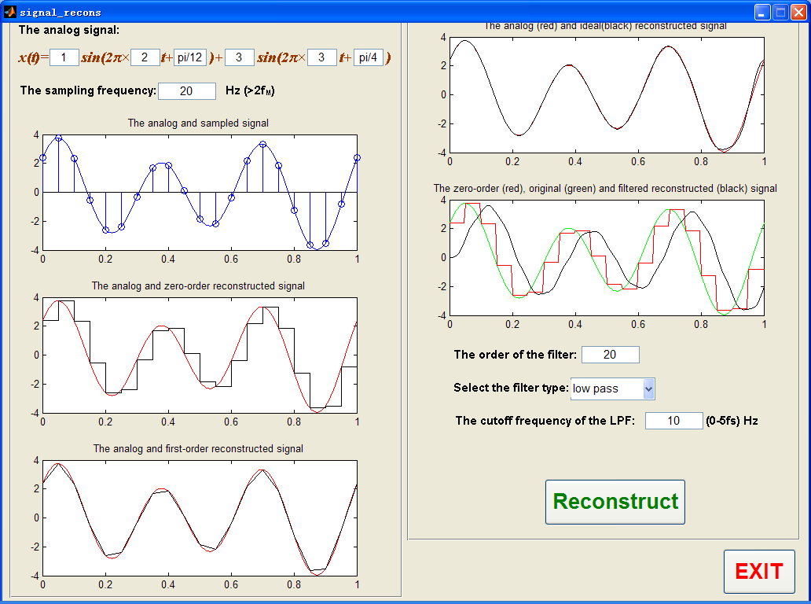
2. Reconstruction of the Continuous-time Signals
>>signal_recons

Slide 9
2.2 Zero-order reconstruction
signal_f=10;
t=0:1/(8*signal_f):0.5;
x=cos(2*pi*signal_f*t);
stairs(t,x);
%draw a stairstep graph of the elements in
% vector t at the locations specified in x.
axis([0 0.3 -1.2 1.2]);

Slide 10
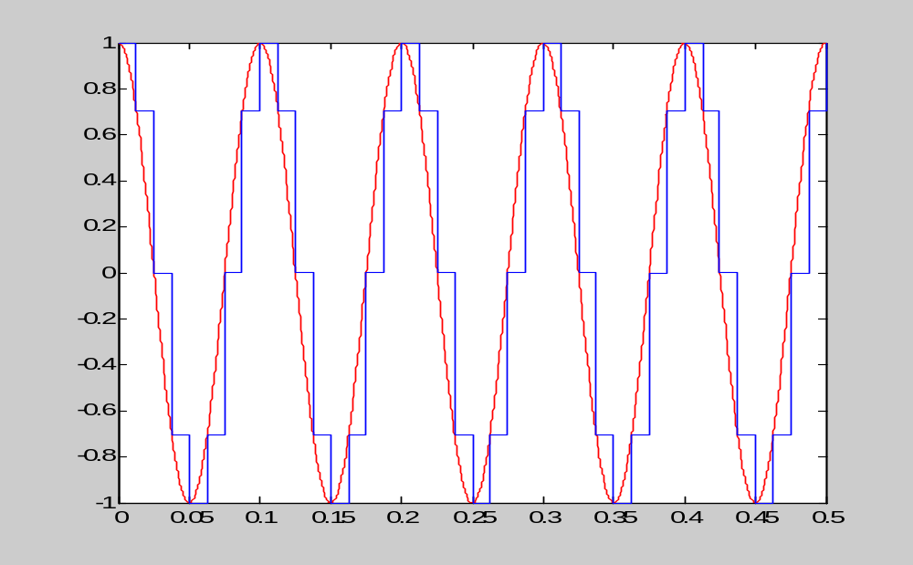
2.2 Zero-order reconstruction

Slide 11
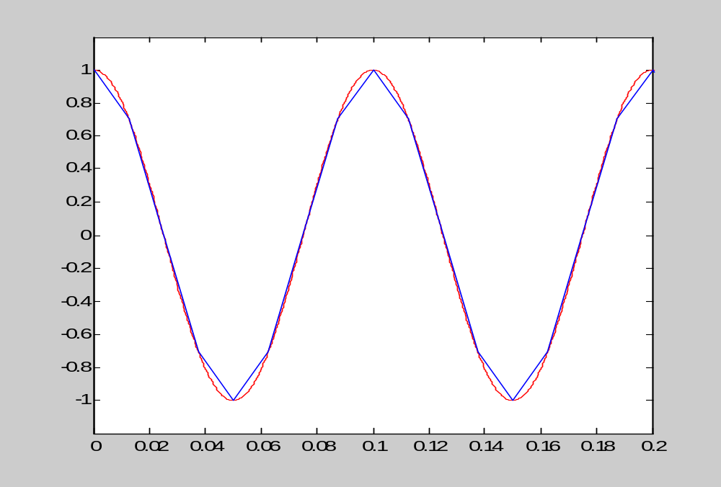
2.3 First-order reconstruction
plot(t,x);

